Slide 1

PKNCA for Noncompartmental Analysis in R
9 September 2023
Bill Denney
Human Predictions, LLC

Slide 2
Learning objective
Question: How does PKNCA allow users to manually select the parameters for calculation for a treatment group, study, and time?
Choices:
The PKNCA.options() function
The intervals argument to the PKNCAdata() function
Providing dosing data to the PKNCAdata() function
Only automatic selection is supported

Slide 3
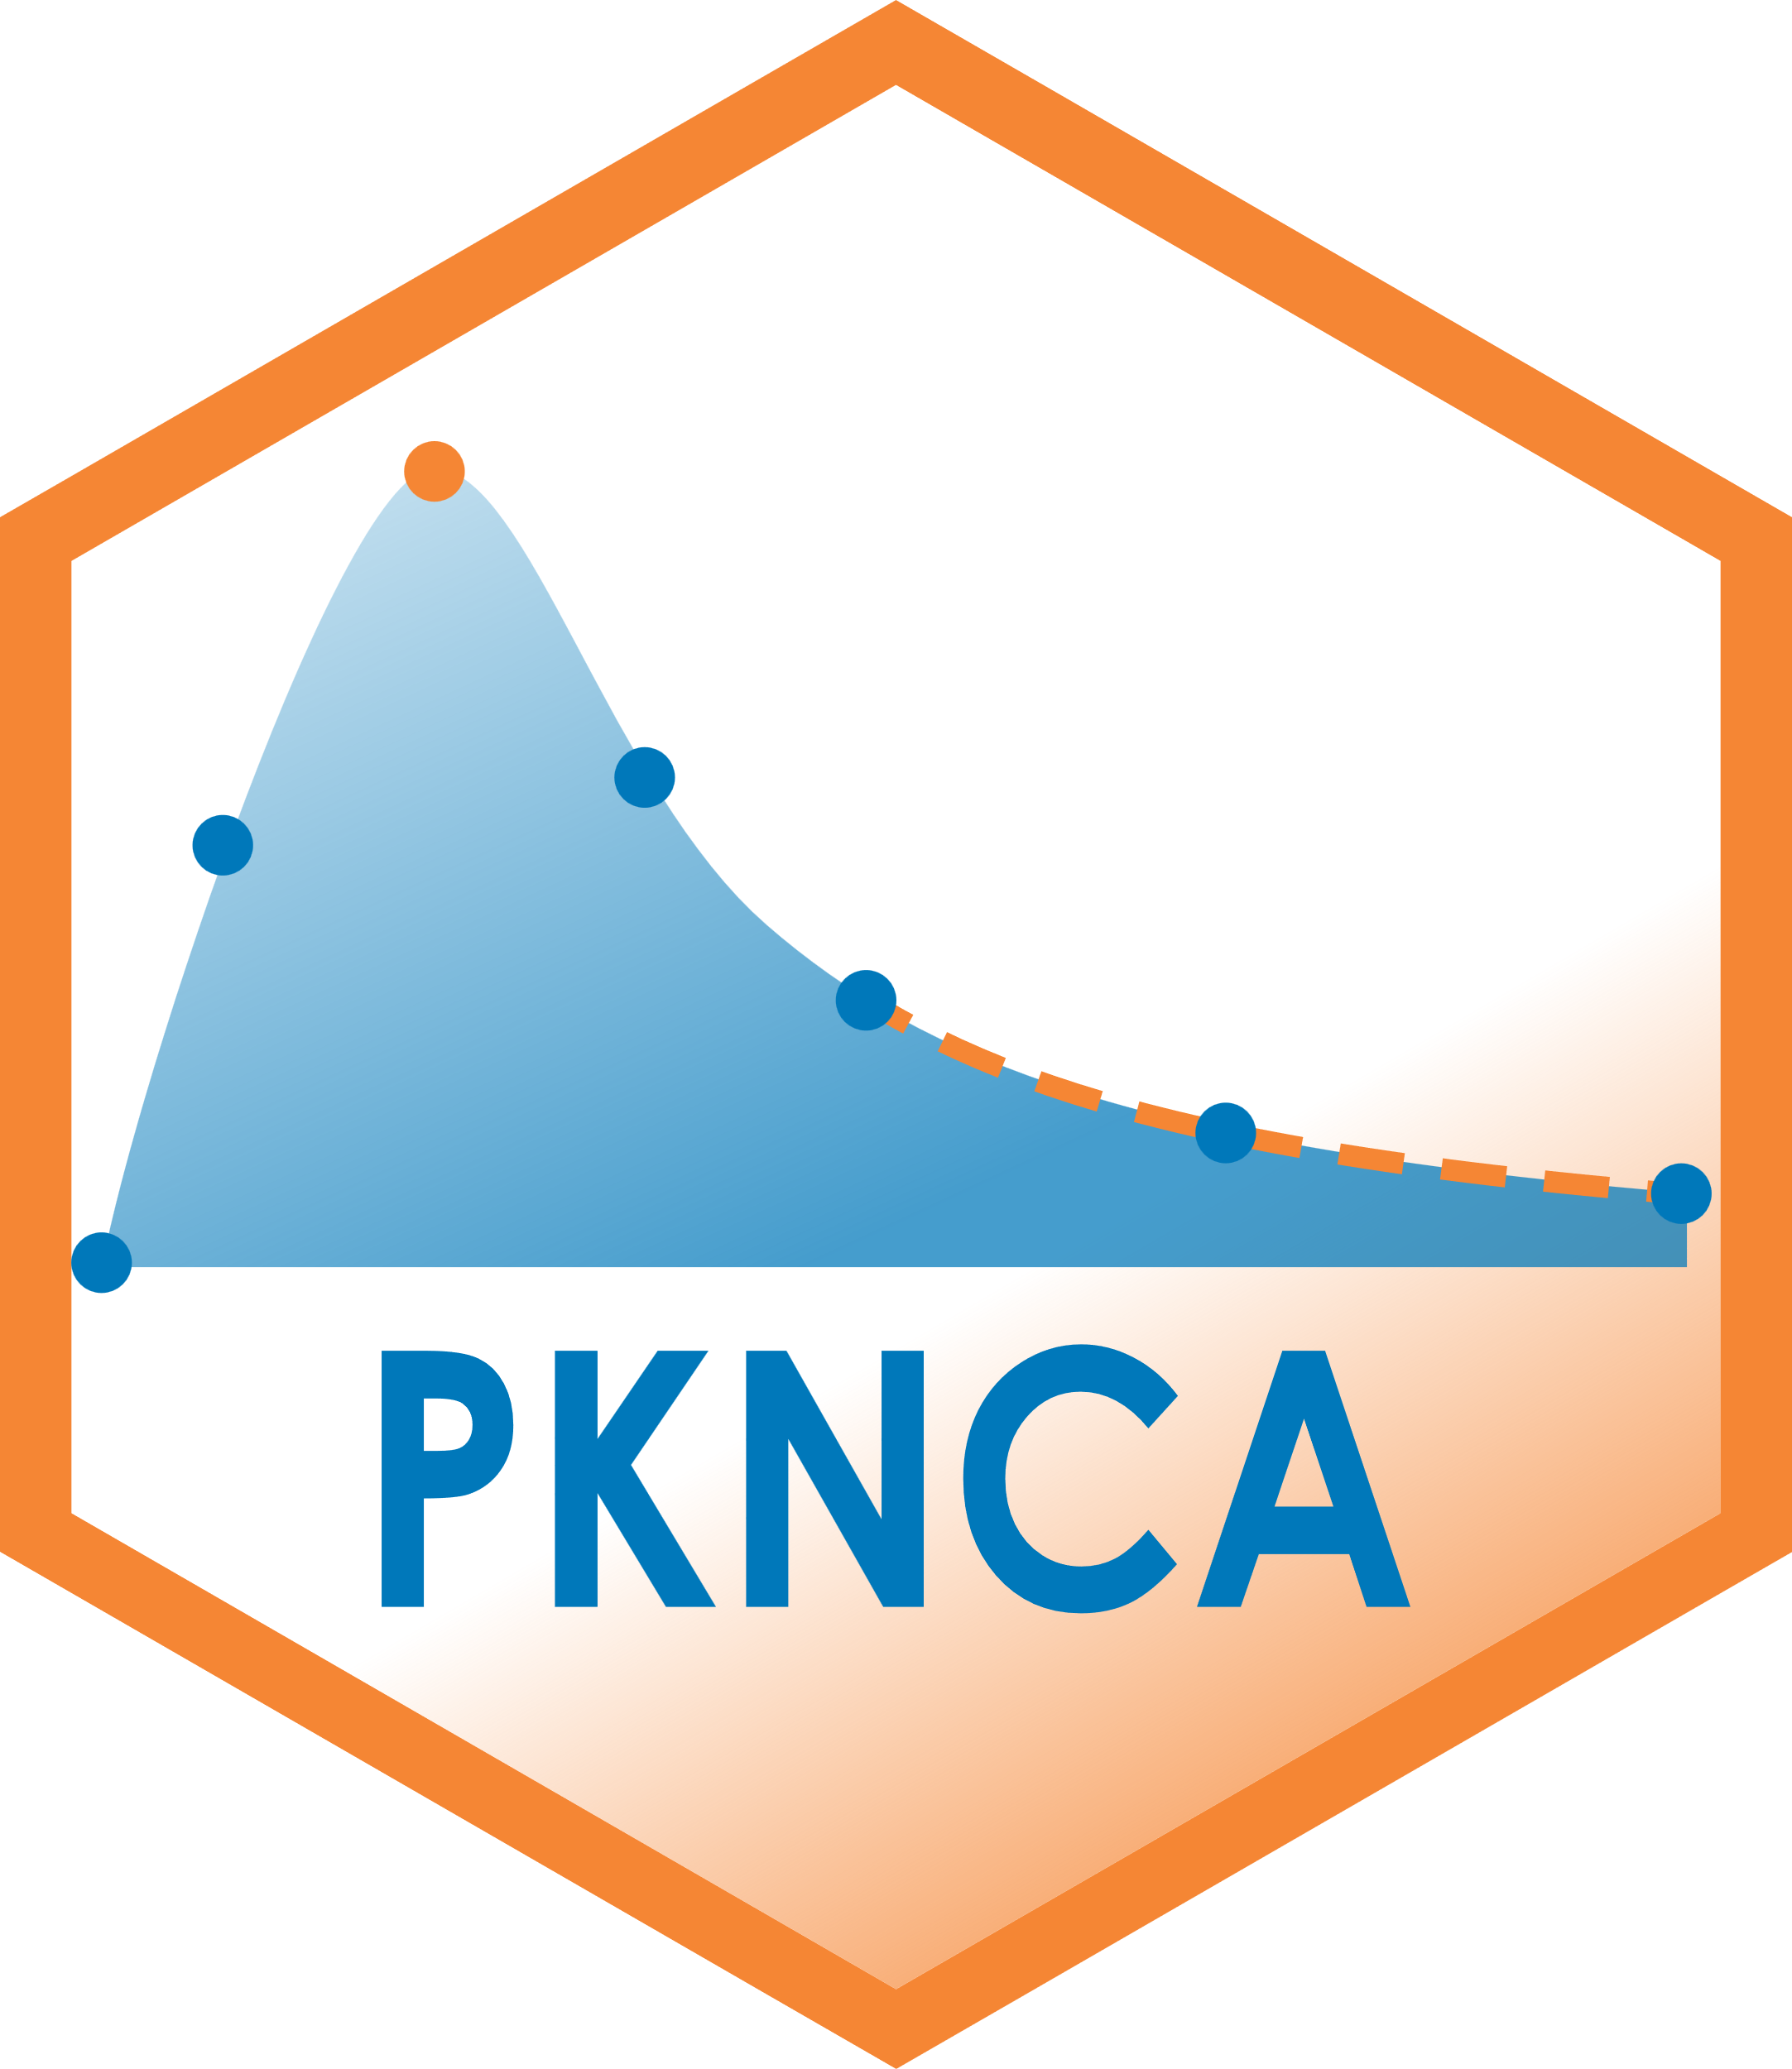
What is PKNCA?
PKNCA is a validated, open-source noncompartmental analysis (NCA) package for R.
It enables NCA for clinical and nonclinical data with a focus toward real-world analyses (handling missing data and actual time analysis).
(Come get a hex sticker!)

Slide 4
How does PKNCA work?

Slide 5
NCA in 5(+3) Lines of R
library(PKNCA)
d_conc <- read.csv("conc.csv") | # Load the PK concentration data
d_dose <- read.csv("dose.csv") | # Load the dosing data
o_conc <- PKNCAconc(d_conc, concentration~time|treatment+subject) | # Create a concentration object. (Note that any number of grouping # levels is supporting; you are not restricted to this list.)
o_dose <- PKNCAdose(d_dose, dose~time|treatment+subject) | # Create a dosing object.
o_data <- PKNCAdata(o_conc, o_dose) | # Combine the concentration and dosing information to automatically # define the intervals for NCA calculation and provide doses for # calculations requiring dose.
o_results <- pk.nca(o_data) | # Calculate the NCA parameters
summary(o_results) | # Summarize the results

Slide 6
Any questions?
?

Slide 7
What does PKNCA do?
Organizes concentration/time and dose/time data
Predicts what you most likely need from NCA parameters from the concentration and dosing data.
Allows user control of all NCA parameter and summary calculations
Does everything according to your business rules
Calculates all (standard) NCA parameters
Targeting almost all of the SDTM PK parameter terms
Summarizes the parameters

Slide 8
A bit more explanation…
Data are arranged similarly to SDTM, but PKNCA doesn’t require SDTM
The PKNCAconc object is like SDTM PC.
The PKNCAdose object is like SDTM EX.
The PKNCAdata object is like ADaM ADPC.
The PKNCAresults object is like SDTM PP.

Slide 9
PKNCA follows your rules
The PKNCA.options function lets you set all calculation options.
When combining concentration and dosing data, PKNCA automatically determines the intervals to use and which parameters to calculate.
You can override those intervals either before or after they are generated.
Only the parameters requested and dependencies are calculated; it doesn’t calculate every parameter for every subject in every interval.
PKNCA ensures reproducibility by storing the inputs, outputs, and decisions made by the user along with the computational environment details.

Slide 10
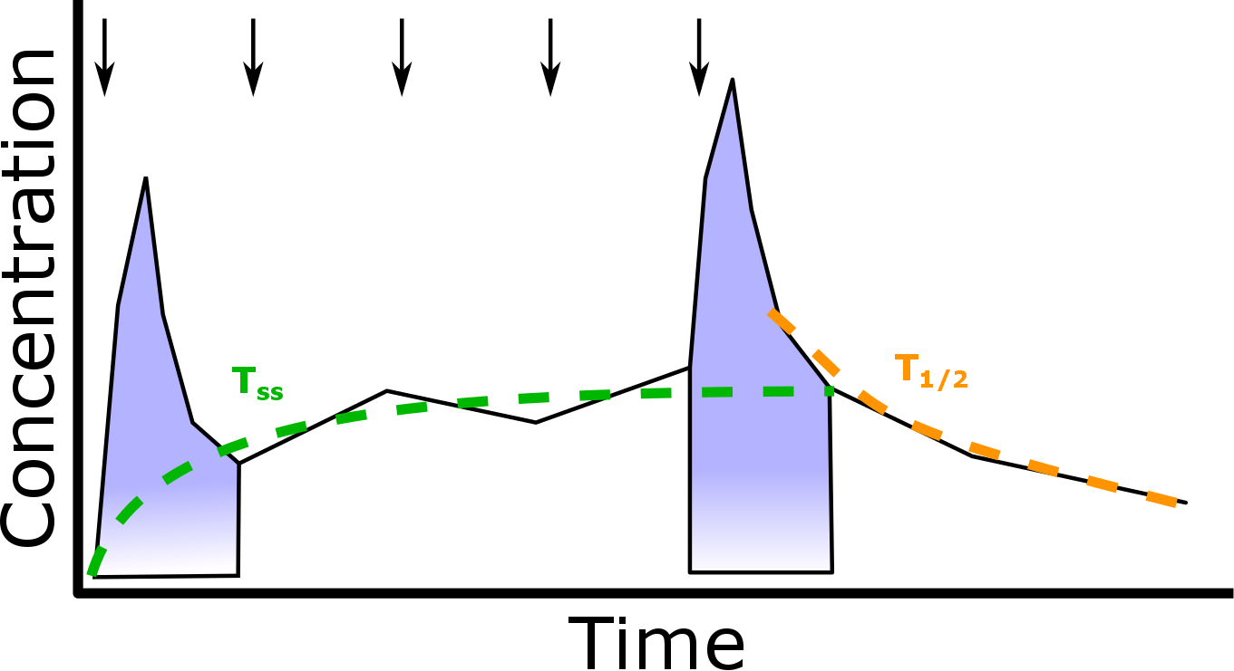
Automatic interval selection

Slide 11
Putting concentration data into PKNCA
Read in your data however makes sense for you (load a .csv file, connect to a database, read from a webserver, …)
d_conc <- read.csv("concentration.csv")
Make a PKNCAconc object specifying the columns for concentration, time, and grouping factors.
o_conc <- PKNCAconc(d_conc, concentration~time|treatment+subject)
Subject is automatically detected as the last grouping factor before a /
o_conc <- PKNCAconc(d_conc, concentration~time|treatment+subject/analyte)

Slide 12
Putting dosing data into PKNCA
As for PKNCAconc, read the data in however works in your environment.
d_dose <- read.csv("dose.csv")
Indicate the dose amount, dosing time, and grouping factors.
o_dose <- PKNCAdose(d_dose, dose~time|treatment+subject)
The amount and time columns can be named anything, but the grouping factors must be a subset of the groups for PKNCAconc.
o_conc <- PKNCAconc(d_conc, concentration~time|treatment+subject/analyte)
o_dose <- PKNCAdose(d_dose, dose~time|treatment+subject)
o_dose <- PKNCAdose(d_dose, dose~time|study+treatment+subject)

Slide 13
Combining Concentration and Dose Data
When combined, intervals can be automatically determined from concentration and dosing objects.
o_data <- PKNCAdata(o_conc, o_dose)
… or you can specify the intervals
o_intervals <-
data.frame(start=0, end=c(24, Inf),
cmax=c(FALSE, TRUE),
tmax=c(FALSE, TRUE),
auclast=TRUE,
aucinf.obs=c(FALSE, TRUE))
o_data <- PKNCAdata(o_conc, o_dose,
intervals=o_intervals)
And when combined, this is the time to set any non-default options
o_data <- PKNCAdata(o_conc, o_dose, options=list(first.tmax=TRUE))

Slide 14
What is necessary to use PKNCA for reporting?

Slide 15
You’ve done all the work– Get results!
One command does all the calculations,
o_results <- pk.nca(o_data)
You can extract the individual measurements
as.data.frame(o_results)
And summarize them
summary(o_results)
start | end | Subject | PPTESTCD | PPORRES
0 | Inf | 1 | auclast | 147.2347
0 | Inf | 1 | cmax | 10.5
0 | Inf | 1 | tmax | 1.12
0 | Inf | 1 | tlast | 24.37
0 | Inf | 1 | lambda.z | 0.048457
0 | Inf | 1 | r.squared | 1
… | … | … | … | …
start | end | auclast | cmax | tmax | half.life | aucinf
0 | 24 | 74.6 [24.3] | . | . | . | .
0 | Inf | . | 8.65 [17.0] | 1.14 [0.630, 3.55] | 8.18 [2.12] | 115 [28.4]

Slide 16
PKNCA extensions

Slide 17



Additional features
NEW! Graphical interface with the ruminate shiny app
https://ruminate.ubiquity.tools/
Use PKNCA with the babelmixr2 package to get automatic starting values for nlmixr2 PK models
https://nlmixr2.github.io/babelmixr2/

Slide 18
Where to go from here?
GitHub
https://github.com/billdenney/pknca/
Development happens on GitHub
CRAN:
https://cran.r-project.org/web/packages/PKNCA/
Ask a question now or later
Contribute: It’s open source!
Data, code, test cases, documentation, requests…

Slide 19
Hands-on exercise
(or a whale of a good time)

Slide 20
Hands-on: Calculate the AUC and Cmax of steady-state amikacin in a beluga and a killer whale
Data:
d_conc <- read.csv("https://raw.githubusercontent.com/billdenney/pknca/main/data-raw/whale/whale_conc.csv")
d_dose <- read.csv("https://raw.githubusercontent.com/billdenney/pknca/main/data-raw/whale/whale_dose.csv")

Slide 21
Hands-on solution
library(PKNCA)
d_conc <- read.csv("https://raw.githubusercontent.com/billdenney/pknca/main/data-raw/whale/whale_conc.csv")
d_dose <- read.csv("https://raw.githubusercontent.com/billdenney/pknca/main/data-raw/whale/whale_dose.csv")
head(d_conc)
head(d_dose)
o_conc <- PKNCAconc(concentration~time|Animal, data=d_conc)
o_dose <- PKNCAdose(dose~time|Animal, data=d_dose)
o_data <- PKNCAdata(o_conc, o_dose)
o_data$intervals
o_nca <- pk.nca(o_data)
summary(o_nca)
summary(o_nca, drop.group=c())
as.data.frame(o_nca)

